Slide 1
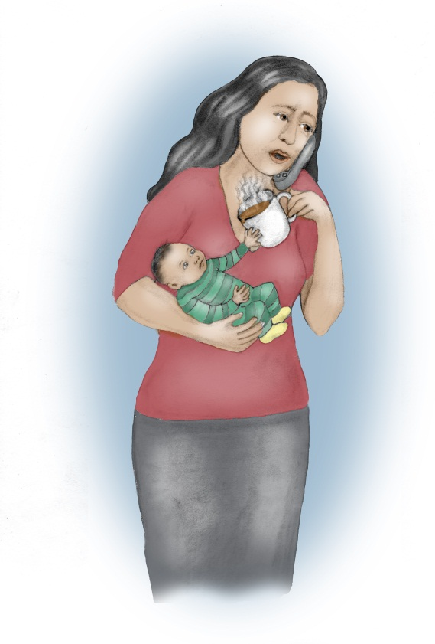
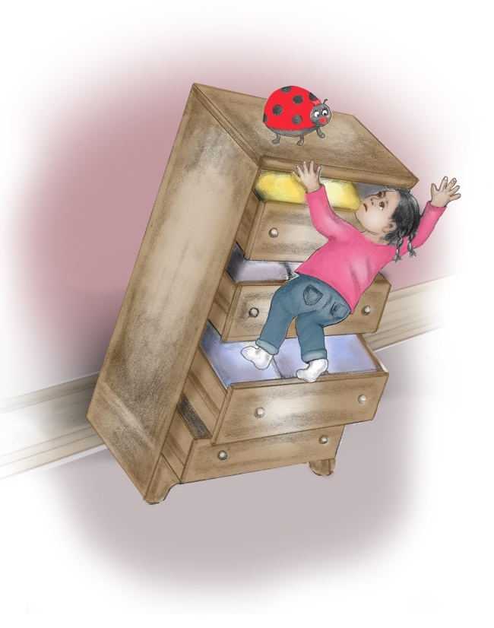
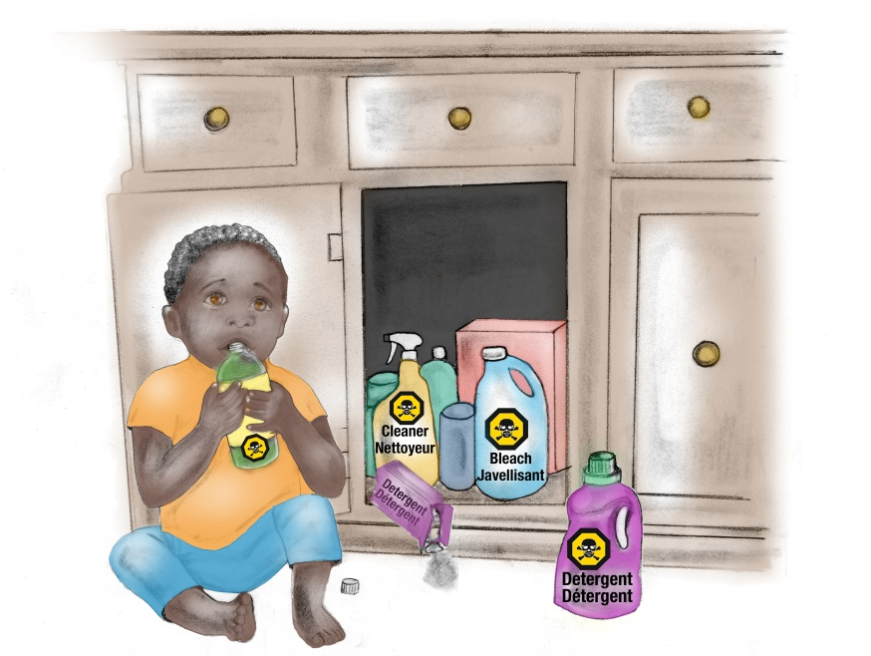
Prevent Child Injury
Notes:
Please note that for this presentation you need to provide participants with a pen and paper or flip chart paper and markers to complete a group activities. An internet connection is also of benefit to share the prevent child injury website and emails.
Welcome everyone to the to the Prevent Child Injury workshop.
Introduce yourself and depending on the number of participants in the room, encourage participants to introduce themselves and share the age of their child/children.
Highlight that today the focus will be on discussing child safety, ideas for preventing injuries, and where to go for more information.

Slide 2
Injuries
What is an injury?
What are the different types of injuries?
Why are injuries common in children?
Notes:
What is an Injury?
Injuries are defined as all the ways an individual can be physically hurt, impaired, or killed, involving intentional or unintentional damage to the body (Ontario Ministry of Health Promotion, 2007, Ontario’s injury prevention strategy: working together for a safer, healthier Ontario)
Types of Injuries:
Injuries can be intentional or unintentional, depending on the ‘intent’ to cause harm.
Intentional injuries include actions such as self-harm, suicide, assault, homicide, and abuse.
Unintentional injuries can include falls, poisoning, burns, scalds, car crashes, or drowning.
Common Injuries:
Injuries occur in young children as they develop and explore their surroundings. Their bones, muscles, vision, and balance are still developing. They are learning new skills all the time and don’t have the risk management skills that adults have to judge whether or not their activities are safe.

Slide 3
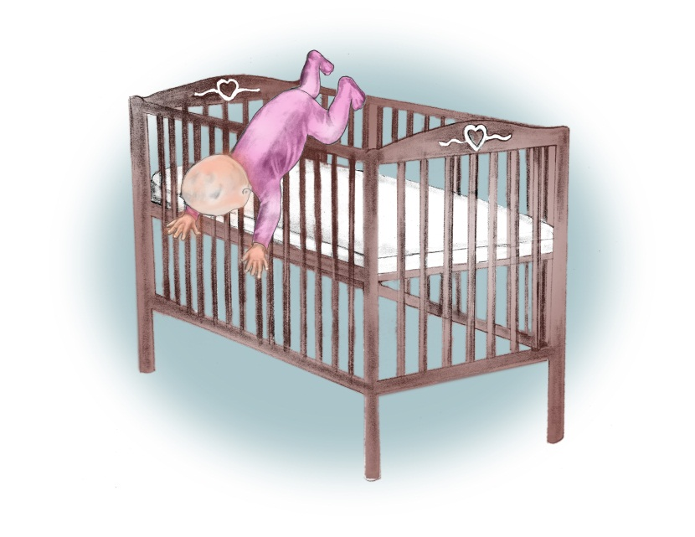
In Canada…
25 children die from injury every month
every day 80 children require hospitalization
home injuries are the most common
Notes:
In Canada:
In Canada, injury is the leading cause of death for children and accounts for approximately 30% of all deaths in the country (1)
Injury is also the largest health problem that has the greatest potential of being prevented through the provision of safe, healthy environments
Furthermore, it is estimated that every month 25 children die from injury in Canada, which is equivalent to one classroom of children dying per month
While every day, 80 children are hospitalized due to unintentional injuries
Investing in prevention strategies would decrease the overall cost of injuries. For example, every $1 spent on prevention education by pediatricians, saves $10 in injury costs. (2)
In Ontario:
Household injuries are most common among children zero to four years of age (3)
Local – if local stats available, this is a great time to share them with participants.
References
1 MacKay, M., Vincenten, J., Brussoni, M., Towner, E., & Fuselli, P. (2011). Child safety good practice guide: Good investments in unintentional child injury prevention and safety promotion - Canadian Edition. Toronto: The Hospital for Sick Children.
2 Fuselli, P., Groff, P., Nesdale-Tucker, R., Waldie, R., Wanounou, A. The Financial Costs, and Prevention Strategies of Unintentional Injuries. Public Sector Digest. January 2011.\
3 Peden, M., Oyegbite, K., Ozanne-Smith, J.. Hyder, A., Branche, C., & Rahman, A. F. (Eds). (2008). World report on child injury prevention. Geneva, Switzerland: World Health Organization.

Slide 4
Leading Ontario Child Injuries
Falls
Scalds and Burns
Poisonings
Notes:
Ontario’s Leading Injuries:
There are many ways a child can be injured
Children under five years old are most often injured from a fall, scald or burn, or they are poisoned
How can children be injured by falls, scalds, burns, or poisonings?
Falls can happen from change tables, cribs, furniture, or down stairs
Scalds and burns can happen from spilled coffee or tea, bath water that is too hot, or hot foods
Children can be poisoned by prescription or over the counter medication, vitamins, cleaning supplies, hand sanitizer, or make-up
References:
Ontario Injury Prevention Resources Centre (2012). Ontario Injury Data Report. SMARTRISK: Toronto, ON.
Yanchar, N. L., Warda, L. J., Fuselli, P., & Canadian Paediatric Society (2012). Child and youth injury prevention: A public health approach. Accessed August 8, 2014, http://www.cps.ca/documents/position/child-and-youth-injury-prevention#Table1

Slide 5
Importance of Play
Child development
Physical activity
Achieving balance between safety and play
Notes:
Importance of Play:
Play is an important part of early child development
Through play, children develop their:
fine and gross motor skills
language skills through interactions
social and emotional skills
The aim of promoting child safety is not to reduce children’s physical activity or to prevent them from exploring their environment due to the fear of them getting hurt
Therefore, injury prevention efforts are focused on recognizing and reducing the risks for serious injuries (due to falls, burns/scalds and poisoning) so the child can be kept safe during play or any other situation – not to restrict their movements or reduce their play time

Slide 6
What?
So What?
Now What?
Notes:
“What? So What? Now What?” are three questions to help you think about child safety. It helps us to pay attention to the new skills your child is developing and determine their risk for injury. Then we can think of ways to keep your child safe.
What can my child do now?
So what can hurt my child?
Now what can I do to keep them safe?

Slide 7
WHAT can my child do now?
Identify fine or gross motor skill
Example:
Child starts to roll from back to stomach
Notes:
What can my child do now? Children are continuously changing and developing new skills. Being able to recognize what they can do based on their stage of development is important when preventing any injury. Therefore, the “What?” question is designed to prompt you to first consider what activities your child can do. For example, you identify that your child is starting to roll around.
If you use the Nippissing District Developmental Screens with your families, this is another great resource to share with families to support them in identifying developmental milestones.

Slide 8
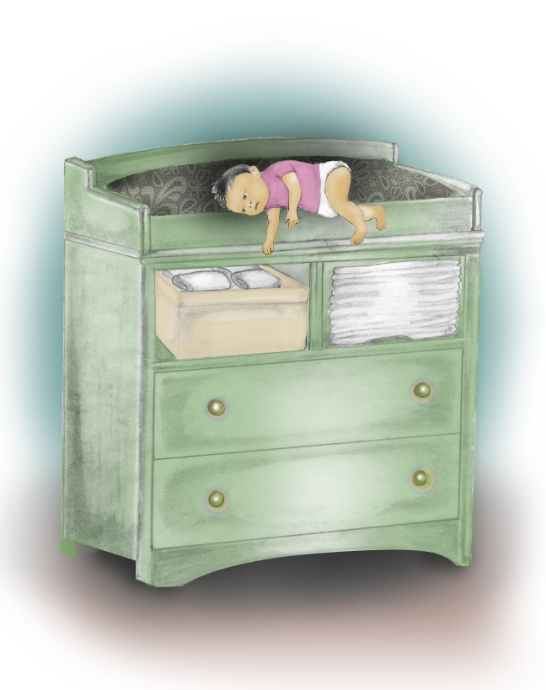
SO WHAT can hurt my child?
Identify the risks for injury
Example:
Since the child can roll around, the child is at risk for falls.
Notes:
So what can hurt my child? As your child develops new motor skills their risk for injuries change. Being able to identify potential dangers allows you to think ahead and assess your home environment for any possible risks that can affect your child in relation to their newly developed skill. Therefore, the “So What?” question is designed to prompt you to explore and identify home hazards. For example, you identify that their child is now at risk for falling from places like change tables and couches because they are starting to roll around.

Slide 9
NOW WHAT can I do to keep my child safe?
Identify strategies to prevent the injury
Example:
Since the child is at risk for falls, keep a hand on the child while on high surfaces
Notes:
Now what can I do to keep my child safe? After new dangers have been identified, it is now time to develop a plan to keep your child safe. Knowing how to prevent these injuries before they happen is the most important step. Therefore, the “Now What?” question is designed to help you find ways to prevent injuries based on your child’s skills and risks. For example, since your child is at risk for falls, placing a hand on your child while they are on a high surface such as a change table, bed, or couch, keeps them from falling off.

Slide 10
What What can my child do now? | So What So what can hurt my child? | Now What Now what can I do to keep my child safe?
My child is starting to roll around. | My child could fall from places like change tables or couches. | I can keep a hand on my baby when placed on any type of furniture.
My child is starting to put things in or near their mouth. | My child could be poisoned if they grabbed a hold of something poisonous. | I can keep any medicine, vitamins, make-up, and cleaning supplies locked up and out of reach.
My child is starting to pull themselves up to stand. | My child could get burned when reaching for hot things on stoves. | I can let my child play on the floor or secure them in their highchair while I prepare meals.
Notes:
Here are some more examples of how “What? So What? Now What?” can be used to prevent falls, poisonings, and scalds or burns. (go through the chart with particapants)

Slide 11
Applying What? So What? Now What?
What can my child do now? | So what can hurt my child? | Now what can I do to keep my child safe?
Notes:
ACTIVITY NAME: Interactive Activity - Child Safety Activity
TIMING: 15-18 mins
REFERENCE PAGES: 14-27
SUPPLIES: Child Safety Activity Handout and pens or flip chart paper and markers; key messages chart
_______________________________________________________________________
(It is the expectation that participants will be able to apply the What? So What? Now What? concept. Lead the participants through this activity. Participants can work individually or in groups. Hand out pens and copies of the Child Safety Activity sheet or draw attention to flip chart paper.)
We are now going to apply What? So What? Now What? to your children through a quick activity. Think about your child and what activities they can do now? What activities will they be able to do soon? Write 3 skills or activities down under What can my child do now? Then think about how that is a risk for injury. Based on these skills, write down how your child can be hurt under So what can hurt my child? Remember to keep in mind that falls, scalds and burns, and poisoning are among the leading injuries in Ontario. Last, think about ways you can protect your child and write those down under Now what can I do to keep my child safe? You have about 10 minutes and then we’ll share some answers as a group.
(Support brainstorming answers around the room. Take up answers in a larger group using the key messages chart as a resource.)
Inform participants that they can take the handout home and fill in more of the boxes as their child continues to develop. This will help parents/caregivers learn how to use “What, So What, Now What” at home.

Slide 12
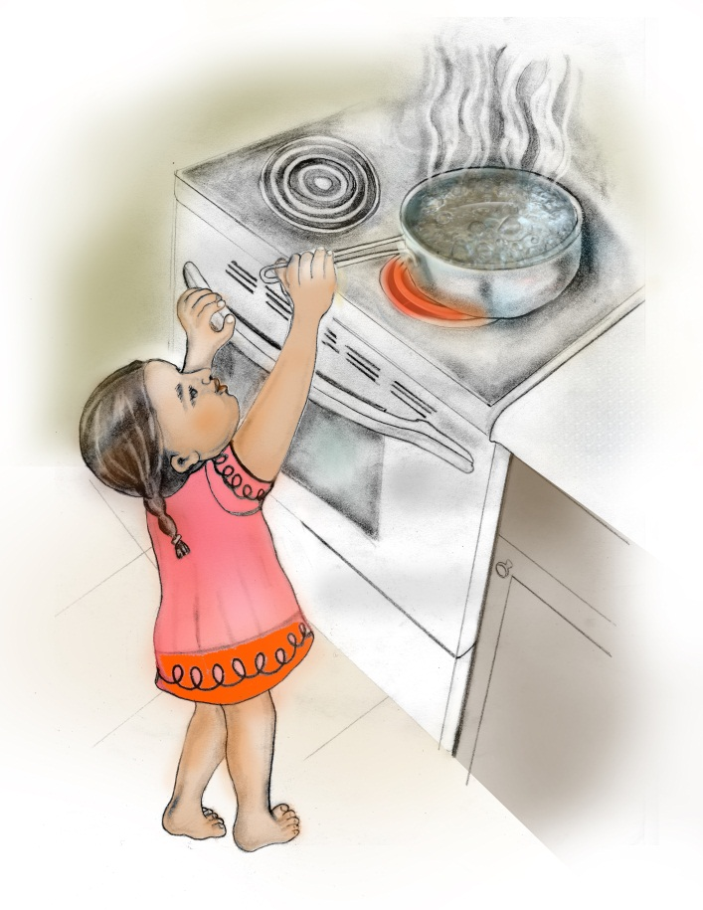
What does it mean?
Child’s Level
Out of Reach
Notes:
There are many resources in the community and on the internet on child safety. Many refer to “a child’s level” or “placing things out of reach”. What do these mean to you? (pause and wait for answers)
Child’s level – This is everything a child sees or touches while lying, sitting, standing or climbing based on their stage of development
Out of reach – This means that a child should not be able to touch anything when reaching, crawling, standing or climbing. Remember that little hands can reach into places that adult hands usually cannot.

Slide 13
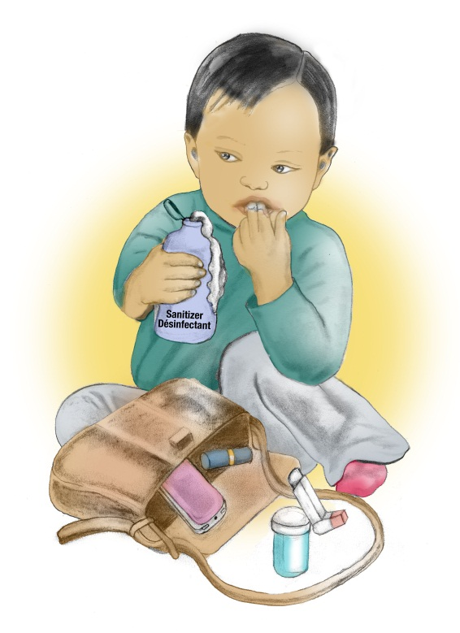
Places to go for more information
www.preventchildinjury.ca email messages
Public Health
www.ndds.ca
www.parachutecanada.org
www.hc-sc.gc.ca/index-eng.php
http://www.mto.gov.on.ca/english/safety/carseat/choose.shtml
Notes:
If you need more information on child safety, please feel free to connect with me or any one of our staff at any time. Other great sources of information are:
www.prevent child injury.ca This website has information on What? So What? Now What? and you can sign up to receive emails every few months on child safety. The emails are based on your child’s date of birth so that they are timed with developmental milestones and use the What? So What? Now What? questions as a prompt. Just register with your email address and enter your child’s birth date. It is free and you can unsubscribe at any time.
Our local Public Health Unit is another source for more parenting information.
Nippissing District Developmental Screens – free developmental checklists for Ontario parents and caregivers
Parachute Canada – non-profit national injury prevention organization
Health Canada – product safety information
Ministry of Transportation – car seats

Slide 14
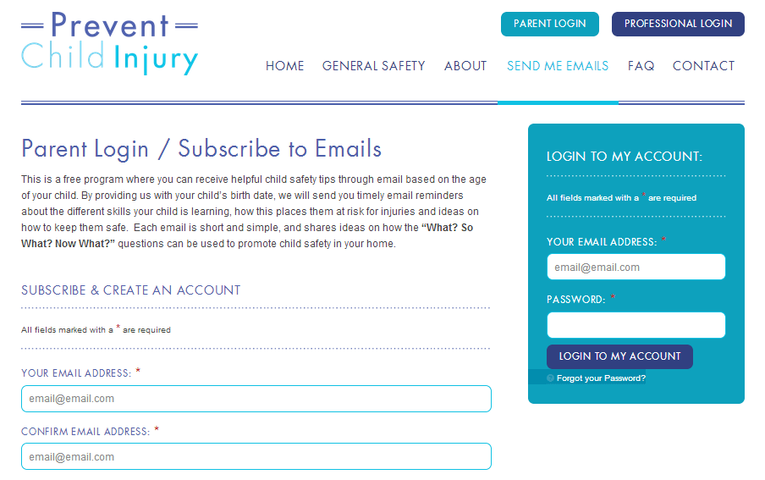
How to Register
Notes:
This is what the registration page looks like to receive the emails.
TIPS
When in slideshow mode: Move the mouse “arrow” over picture until “hand” appears, then click to automatically open to website. Demonstrate parts of the website as time allows.

Slide 15
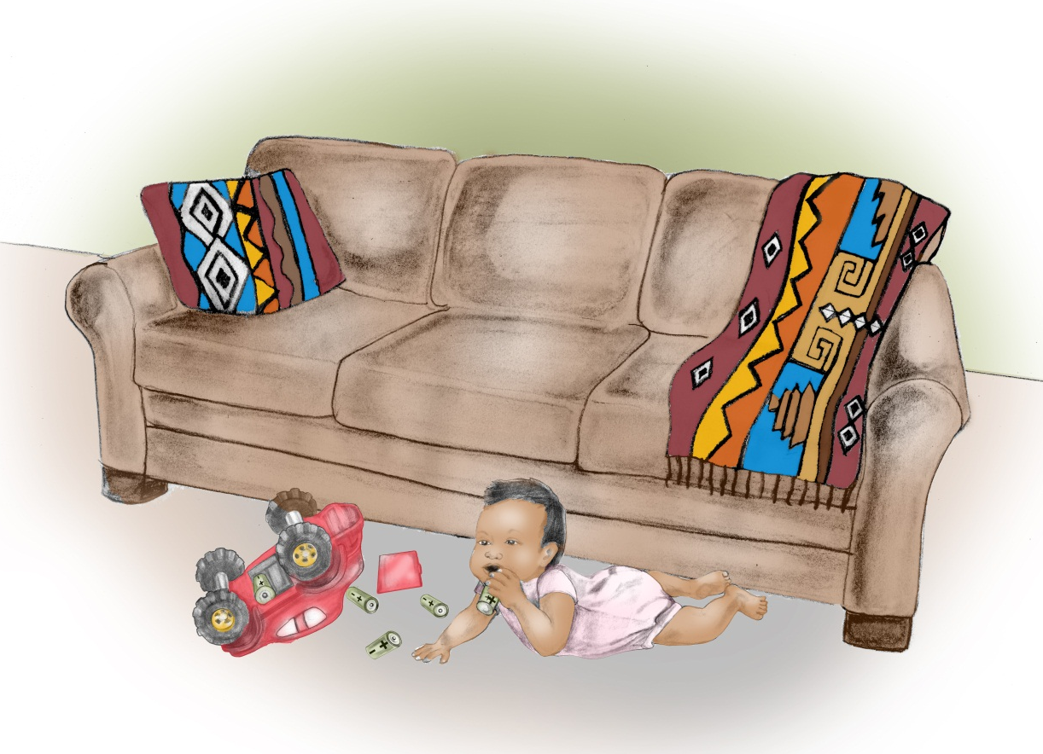
Questions?
Notes:
ACTIVITY NAME: Questions
TIMING: 5 mins
REFERENCE PAGES: Appendix C – Additional Resources in Preparations for Questions
SUPPLIES: none
_______________________________________________________________________
(Encourage participants to ask any additional questions they may still have. It is ok not to have all the answers to the various child safety topic areas. Refer participants to community resources as needed.)
Some questions that may be asked are:
Q Will my child still be able to play? I want them to be active.
A Yes! Making your home safe helps avoid hazards and is not to stop your child from playing. Play is important for a child’s growth and development. These tips are to help make your home safe while your child learns, explores and plays.
--------------------------------------------------------------------------------
Q If my child has not reached the specific age related milestone, should I be concerned?
A Every child is different. The milestones in these emails are general guidelines that are based on what your child may be doing and learning. If you have concerns about your child’s growth and development contact your primary care provider.
--------------------------------------------------------------------------------
Q Is it expensive to make your home safe?
A Most of these safety tips cost little to no money. These messages encourage you to make changes in your home such as moving dangerous objects out of reach and locking up poisonous items. If you are considering making changes to your home, the cost may vary depending on the home safety products that you choose.
--------------------------------------------------------------------------------
Q How can I find out if my child products are safe?
A To find out if the products you have are safe you can refer to:
Health Canada’s Recalls and Alerts (http://www.healthycanadians.gc.ca/recall-alert-rappel-avis/index-eng.php)

Slide 16
Thank you!!!!
Notes:
Thank everyone for attending and participating in this training session.
Let them know that you are available after the session if they have any additional questions or concerns.

