Slide 1
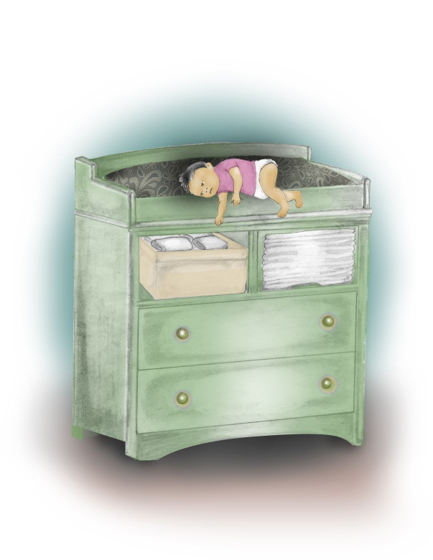
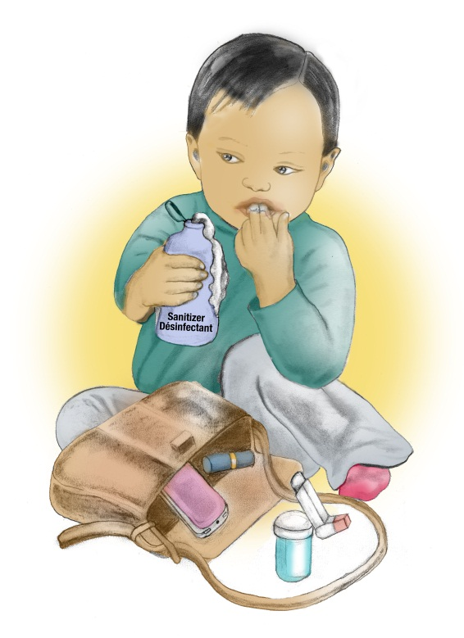
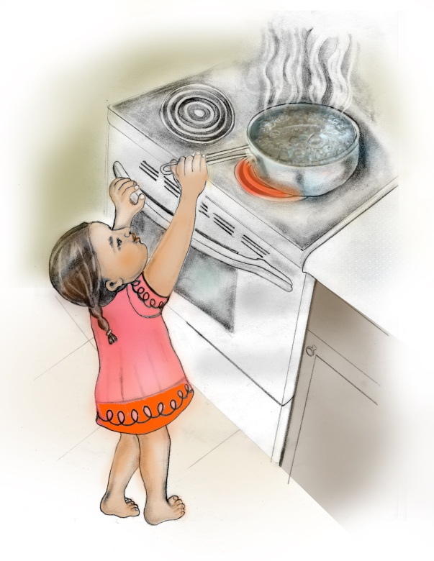
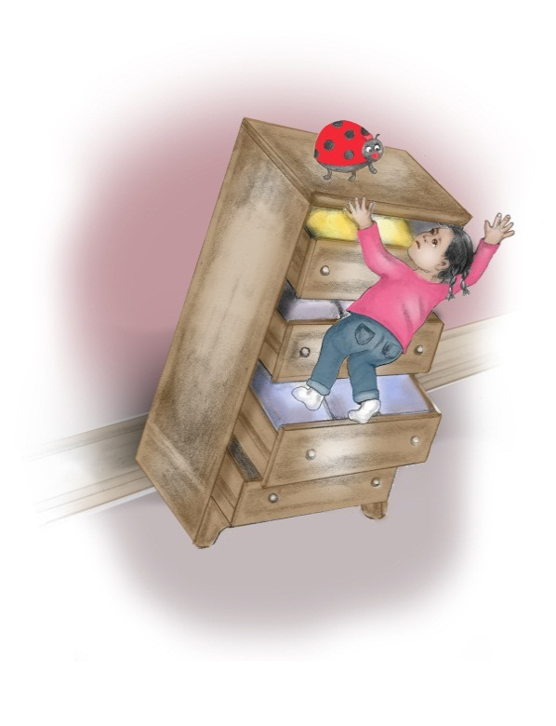
Prevent Child Injury
Notes:
Welcome participants to the Prevent Child Injury workshop.
Introduce yourself and depending on the number of participants in the room, encourage participants to introduce themselves.
Please note that for this presentation you need to provide participants with:
A pen and paper or flip chart paper and markers to complete a group activities and case scenarios
What? So What? Now What? Key Messages Chart (available at www.preventchildinjury.ca on the Professional Login section under Resources tab)
Copies of the Parent/Caregiver workshop Facilitator Guide per participant or agency (available at www.preventchildinjury.ca on the Professional Login section under Resources tab)
Optional – Copy of the Parent/Caregiver PowerPoint Presentation (available at www.preventchildinjury.ca on the Professional Login section under Resources tab)
You will also need an internet connection to access online training videos. These videos are also available at www.preventchildinjury.ca on the Professional Login section under Training Videos tab.

Slide 2
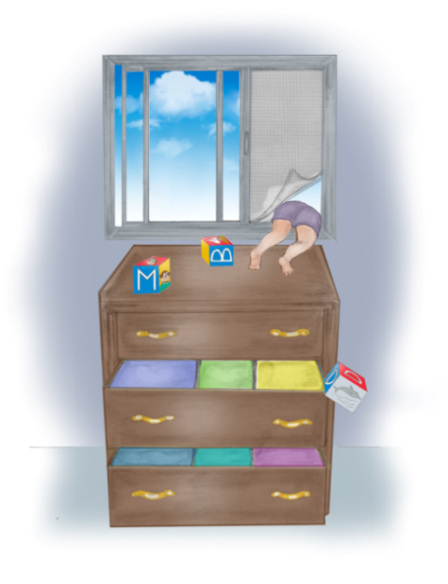
Main Outcomes for Training Others
Broad understanding of injuries in Ontario
Importance of play
What? So What? Now What?
Facilitating workshops
Fostering teachable moments
Website and email messages for families
Additional information/resources
Notes:
Provide a brief overview of the components to be covered during the one hour-long training workshop
Injury overview
Importance of play
“What, So What, Now What” a communication strategy to help parents and caregivers problem solve child safety solutions
Ideas how to facilitate a parenting child safety workshop
Capitalizing on teachable moments
Promoting the email messaging system to your families
Additional information/resources
Questions/Discussion
Icebreaker Activity: Go around the room and have each person introduce them self and state one thing they want to learn from this session

Slide 3
Injuries
What is an injury?
What are the different types of injuries?
Why are injuries common in children?
Notes:
What is an Injury?
Injuries are defined as all the ways an individual can be physically hurt, impaired, or killed, involving intentional or unintentional damage to the body (Ontario Ministry of Health Promotion, 2007, Ontario’s injury prevention strategy: working together for a safer, healthier Ontario)
Types of Injuries:
Injuries can be intentional or unintentional, depending on the ‘intent’ to cause harm.
Intentional injuries include actions such as self-harm, suicide, assault, homicide, and abuse.
Unintentional injuries can include falls, poisoning, burns, scalds, motor vehicle crashes, or drowning.
Common Injuries:
Injuries occur in young children as they develop and explore their surroundings. Their bones, muscles, vision, and balance are still developing. They are learning new skills all the time and don’t have the risk management skills that adults have to judge whether or not their activities are safe.

Slide 4
In Canada…
injuries are the leading cause of death in children
25 children die from injury every month
every day another 80 children require hospitalization
In Ontario…
home injuries are the most common
$310 million in health care costs
Notes:
In Canada:
In Canada, injury is the leading cause of death for children and accounts for approximately 30% of all deaths in the country (1)
Injury is also the largest health problem that has the greatest potential of being prevented through the provision of safe, healthy environments
Furthermore, it is estimated that every month 25 children die from injury in Canada, which is equivalent to one classroom of children dying per month
While every day, 80 children are hospitalized due to unintentional injuries
Investing in prevention strategies would decrease the overall cost of injuries. For example, every $1 spent on prevention education by pediatricians, saves $10 in injury costs. (2)
In Ontario:
Household injuries are most common among children zero to four years of age (3)
In 2004, injuries with children aged one to four years alone had a total of over $310 million in healthcare costs with direct costs over $172 million and indirect costs over $138 million (4)
Local – if local stats available, this is a great time to share them with participants.
References
1 MacKay, M., Vincenten, J., Brussoni, M., Towner, E., & Fuselli, P. (2011). Child safety good practice guide: Good investments in unintentional child injury prevention and safety promotion - Canadian Edition. Toronto: The Hospital for Sick Children.
2 Fuselli, P., Groff, P., Nesdale-Tucker, R., Waldie, R., Wanounou, A. The Financial Costs, and Prevention Strategies of Unintentional Injuries. Public Sector Digest. January 2011.\
3 Peden, M., Oyegbite, K., Ozanne-Smith, J.. Hyder, A., Branche, C., & Rahman, A. F. (Eds). (2008). World report on child injury prevention. Geneva, Switzerland: World Health Organization.
4 SMARTRISK (2009). The Economic Burden of Injury in Canada. Toronto: Author.

Slide 5
Leading Ontario Child Injuries
Falls
Scalds and Burns
Poisonings
Notes:
Ontario’s Leading Injuries:
There are many ways a child can be injured
Children under five years old are most often injured from a fall, scald or burn, or they are poisoned
How can children be injured by falls, scalds, burns, or poisonings?
Falls can happen from change tables, cribs, furniture, or down stairs
Scalds and burns can happen from spilled coffee or tea, bath water that is too hot, or hot foods
Children can be poisoned by prescription or over the counter medication, vitamins, cleaning supplies, hand sanitizer, or make-up
References:
Ontario Injury Prevention Resources Centre (2012). Ontario Injury Data Report. SMARTRISK: Toronto, ON.
Yanchar, N. L., Warda, L. J., Fuselli, P., & Canadian Paediatric Society (2012). Child and youth injury prevention: A public health approach. Accessed August 8, 2014, http://www.cps.ca/documents/position/child-and-youth-injury-prevention#Table1

Slide 6
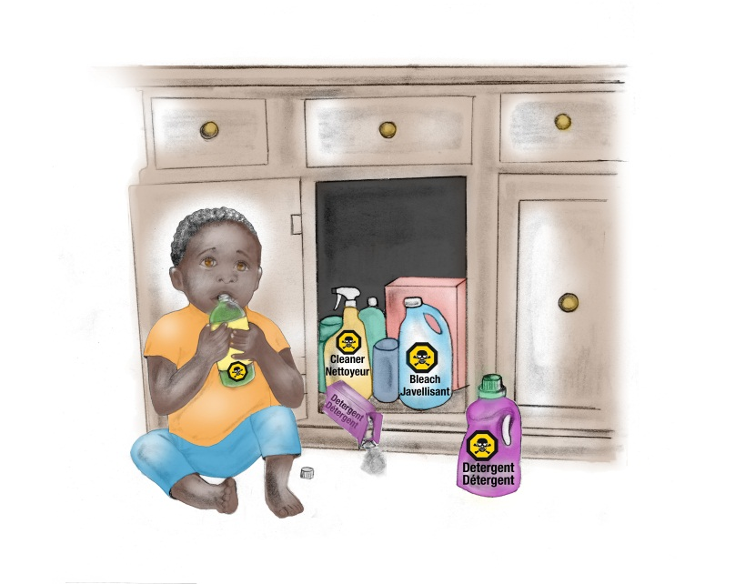
Injuries are Preventable
Parents and caregivers view as accidents
Majority of injuries are preventable
Case Scenario
Notes:
Why Focus on Prevention?
The majority of parents/caregivers view injuries as “accidents,” non-preventable, and a normal part of being a child. We hear “kids will be kids”, “they learn from their mistakes”
It is estimated that the majority of injuries are preventable. That there is something that could have been done to stop the injury before it happened.
Case Scenario (Share this scenario and ask the group for their thoughts. For a larger group you can divide up into smaller groups and have them discuss the case and bring back to larger group. For a smaller group you can discuss the case as a whole):
18 month old Samantha loves to put things in her mouth. Mom is getting ready for work in the bathroom, but leaves to take a phone call from a family member. While mom is on the phone, Samantha opens the cupboard underneath the sink and pulls out the toilet bowl cleaner. She takes a drink of the cleaner before mom comes back from her phone call. Mom realizes what has happened and calls poison control and subsequently has to take Samantha to the hospital where she was admitted for 5 days. How could this poisoning have been prevented?
Possible answers:
Supervision (bring your child with you when you take a call).
Lock up and keep out of reach all hazardous items.
Don’t answer the phone or call back when baby is sleeping.

Slide 7
Importance of Play
Child development
Physical activity
Achieving balance between safety and play
Notes:
Importance of Play:
Play is an important part of early child development
Through play, children develop their:
fine and gross motor skills
language skills through interactions
social and emotional skills
The aim of promoting child safety is not to reduce children’s physical activity or to prevent them from exploring their environment due to the fear of them getting hurt
Therefore, injury prevention efforts are focused on recognizing and reducing the risks for serious injuries (due to falls, burns/scalds and poisoning) so the child can be kept safe during play or any other situation – not to restrict their movements or reduce their play time

Slide 8
What?
So What?
Now What?
Notes:
“What, So What, Now What” is a unique way for parents/caregivers to remember a systematic strategy to prevent injuries in the home setting based on anticipatory guidance principles. The purpose of this strategy is to help parents/caregivers understand what new skills their child is developing, their child’s risk for injury based on those skills, and actions they can take to prevent any harm. “What, So What, Now What” is composed of three questions to help prompt parents/caregivers to assess their home safety situation. The questions are designed to help parents and caregivers identify what works for them in their unique home environment while thinking about child safety.

Slide 9
WHAT can my child do now?
Identify fine or gross motor skill
Example:
Child starts to roll from back to stomach
Notes:
What can my child do now? Children are continuously changing and developing new skills during their first three years of life. Being able to recognize what they can do based on their stage of development is important when preventing any injury. Therefore, the “What?” question is designed to prompt parents/caregivers to first consider what activities their child can do now or what they will be able to do soon. For example, they identify that their child is starting to roll around.
The Nippissing District Developmental Screen tools are a great resource for looking at developmental milestones that you and families can both use together.

Slide 10

SO WHAT can hurt my child?
Identify the risks for injury
Example:
Since the child can roll around, the child is at risk for falls.
Notes:
So what can hurt my child? With every new skill a child develops, a new danger follows. These dangers can put the child at risk for many different injuries. Being able to identify potential dangers allows parents/caregivers to think ahead and assess their home environment for any possible risks that can affect their child in relation to their newly developed skill. Therefore, the “So What?” question is designed to prompt parents/caregivers to explore and identify home hazards. For example, they identify that their child is now at risk for falling from places like change tables and couches because they are starting to roll around.

Slide 11
NOW WHAT can I do to keep my child safe?
Identify strategies to prevent the injury
Example:
Since the child is at risk for falls, keep a hand on the child while on high surfaces
Notes:
Now what can I do to keep my child safe? After the new dangers have been identified, it is now time to develop a plan to keep their child safe. Knowing how to prevent these injuries before they occur is the most important step. Therefore, the “Now What?” question is designed to prompt parents/caregivers to lastly identify prevention strategies that work best for them. For example, since their child is at risk for falls, they would keep a hand on their child when they are on a high surface such as a change table, bed, or couch to keep them from falling off.

Slide 12
Applying What? So What? Now What?
4 month old – can swing at dangling objects
8 month old – puts things in mouth
15 month old – starts to climb
What can my child do now?
So what can hurt my child?
Now what can I do to keep my child safe?
Notes:
Group Activity
(It is the expectation that participants will be able to apply the What? So What? Now What? concept with their families. It is also an expectation for participants to be able to assists parents/caregivers to apply this concept when hosting a child safety workshop. Lead the participants through the group activity. Participants can work individually or on groups.)
We are now going to apply the What? So What? Now What? concept to a few case scenarios so that you are comfortable with this concept and can teach it to parents/caregivers. On your paper, please write down the headings What? So What? and Now What? (pause) Under the What? heading, write down the age and skill of the child as seen on this slide. Work together or individually to brainstorm answers to the So What? and Now What? questions. Remember to keep in mind that falls, scalds and burns, and poisoning are among the leading injuries in Ontario.
Possible answers:
4 month old:
What? swing at dangling objects
So What? risk for scalds and burns
No What? a hot drink can badly burn a baby’s skin. Avoid holding babies and hot drinks at the same time or put the hot drink in a travel mug with a tight lid (next page -->)
8 month old:
What? put things in mouth
So What? risk for poisoning (also choking)
Now What? visitors may have prescription medication, tobacco, or other items in their purses or bags that could poison a child. Make sure to place them off the floor and out of child’s reach.
15 months old:
What? starts to climb
So What? risk for falls, poisoning
Now What? before your child starts to climb, keep drawers closed and locked with latches. This way they cannot use the drawers like steps to climb onto counter tops or furniture. Place chairs and stools away from counters or other high places where a child can climb. This way a child wont be able to reach dangerous things on the counter or falls and hurt themselves.

Slide 13
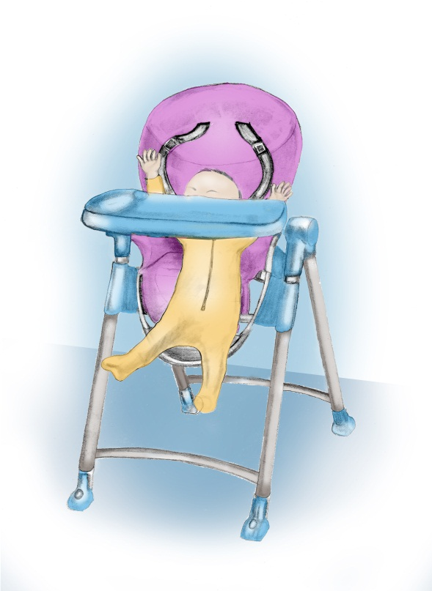
Parent/Caregiver Workshops
Notes:
Now we are going to take some time to talk about how to deliver a parent/caregiver workshop on child safety based on the What? So What? Now What? concept

Slide 14
Resources and Supplies
www.preventchildinjury.ca/professional
Professional Login – Resources Tab
Pens
What? So What? Now What? activity sheet
Key Messages
Facilitator Guide
PowerPoint Presentation – optional
Know your audience – ages of children
Notes:
(Hand out copies of the key messages available on the professional page of www.preventchildinjury.ca under the Resources tab. If able, also provide copies of the Facilitator Guide and PowerPoint Presentation.)
To prepare for the workshop, please take time to review the Facilitator Guide. It has all the content you need for each section. Also available is a sample PowerPoint presentation for those that prefer to present using slides. To facilitate a child safety workshop, you will need to provide pens and an activity sheet that has a chart on it with the What? So What? Now What? questions along the top. There is an example to copy in the Facilitator Guide. All resources for running the workshop are available for free at the website www.preventchildinjury.ca under the Professional Login page. Just select the Resources tab.
It is also important to know the ages of the children of your participants. This will help you to prepare in advance interactive activities that are tailored to the development milestones of your participants’ children.

Slide 15
Workshop Breakdown - Background
Background on injuries
Injuries are preventable
Notes:
The workshop is intended to be quick and only take a half hour of a parents/caregivers’ time.
Start the presentation by reviewing some of the statistics shared today with your families
Then highlight that injuries can be prevented by choosing simple parenting interventions and emphasize the importance of play for child development

Slide 16
What What can my child do now? | So What So what can hurt my child? | Now What Now what can I do to keep my child safe?
My child is starting to roll around. | My child could fall from places like change tables or couches. | I can keep a hand on my baby when placed on any type of furniture.
My child is starting to put things in or near their mouth. | My child could be poisoned if they grabbed a hold of something poisonous. | I can keep any medicine, vitamins, make-up, and cleaning supplies locked up and out of reach.
My child is starting to pull themselves up to stand. | My child could get burned when reaching for hot things on stoves. | I can let my child play on the floor or secure them in their highchair while I prepare meals.
Notes:
Introduce “What? So What? Now What?” by explain each of the questions. Then provide examples of how these questions can be applied at home. Provide an example for each of falls, poisonings, and scalds or burns.

Slide 17
Workshop Breakdown –
What? So What? Now What?
What can my child do now? | So what can hurt my child? | Now what can I do to keep my child safe?
Interactive activity
Applying concept to other injuries
Notes:
Provide participants with the “What? So What? Now What?” activity sheet. This activity can also be done using flip chart paper with the headings and questions.
Ask parents to complete the activity we did earlier by starting to populate the What? section of the activity chart using developmental milestones based on the ages of the attending participants’ children. Aim for at least three different milestones in the What? column.
Then ask participants to work in small groups or individually to answer the So What? and Now What? questions. To keep focused, ask them to think of falls, poisoning, scalds, or burns.
Discuss answers as a larger group. To help support participants link milestones to risks and safety messages, use the key messages chart as a guide and for taking up answers.
Conclude the activity by explaining how “What? So What? Now What?” can be used to prevent drowning, choking, and other injuries. For example, many of the strategies to prevent poisoning also prevents choking. Children able to crawl, walk, open doors, can get access to pools, ponds, lakes, and bath tubs.

Slide 18

What does it mean?
Child’s Level
Out of Reach
Notes:
Many of the Now What? messages include references to a child’s level or placing things out of reach. What do these mean to you?
Child’s level – This is everything a child sees or touches while lying, sitting, standing or climbing based on their stage of development
Out of reach – This means that a child should not be able to touch anything when reaching, crawling, standing or climbing. Remember that little hands can reach into places that adult hands usually cannot.

Slide 19
Workshop Breakdown - Resources
www.preventchildinjury.ca
Email messaging system
Public Health
www.parachutecanada.org
www.hc-sc.gc.ca/index-eng.php
http://www.mto.gov.on.ca/english/safety/carseat/choose.shtml
Notes:
Encourage families to come to you for more information and discuss child safety.
Other community resources:
Promote the www.preventchildinjury.ca website
Promote email messaging system to your clients. This will be discussed in more detail later.
Local Public Health Unit for more information. Many have a central intake line for parenting information.
Parachute Canada – non-profit national injury prevention organization
Health Canada – product safety information
Ministry of Transportation – car seats

Slide 20
Planning for Your Workshop
Time of year
Promotion
Engaging families
Notes:
Consider the time of year to host a workshop. You may be more successful in later fall and winter then spring or summer.
Promote the workshop around your agency through:
Posters (which will be available to post around your agency)
Simple conversations with parents/caregivers (drop-off or pick-up times may be the best way to plant the seed)
Getting parent/caregiver champions or role models from your agency on board first may promote additional attendance
Send home info with parents/caregivers through flyers

Slide 21
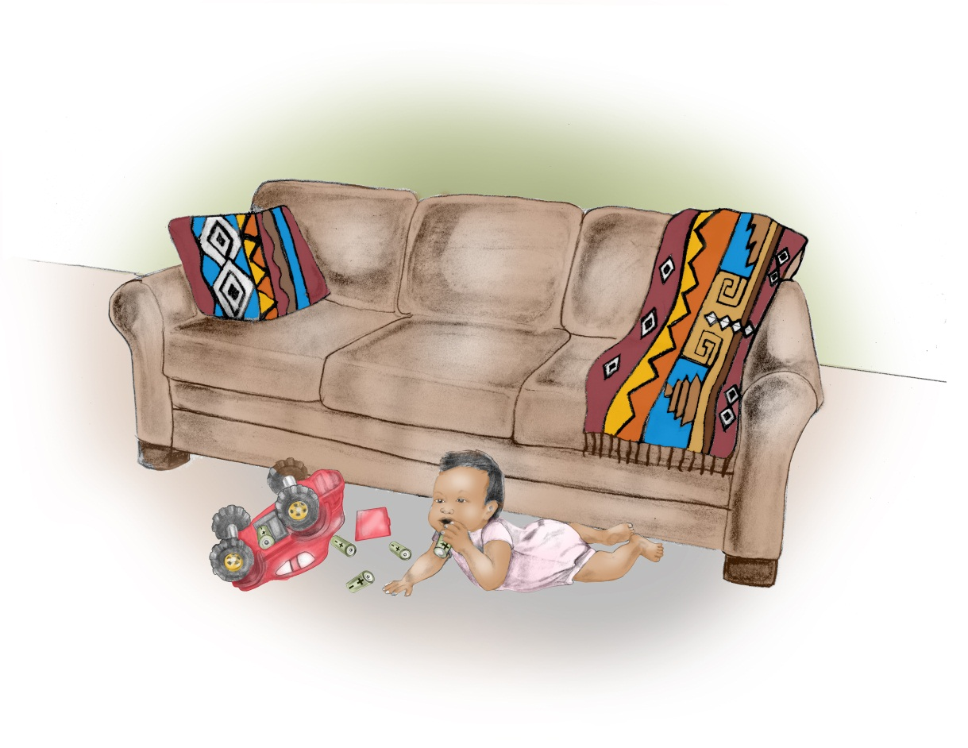
Teachable Moments
Notes:
Now we are going to discuss capitalizing on teachable moments to address child safety.
As professionals that work with children and families every day, you are in a unique and trusted position to discuss child safety.
What is a teachable moment? A teachable moment is an unplanned opportunity that arises where you have an ideal chance to educate or offer insight to a parent/caregiver about childhood injury prevention.
Its an opportunity to participate in reflective practice and engage the family beyond their current environment

Slide 22
Teachable Moments
You observe a child demonstrating a new fine or gross motor milestone
A parent/caregiver shares with you that their child has demonstrated a new fine or gross motor milestone
A parent/caregiver asks a question about child safety
Notes:
3 opportunities for teachable moments in one’s practice
(review bullets above)

Slide 23
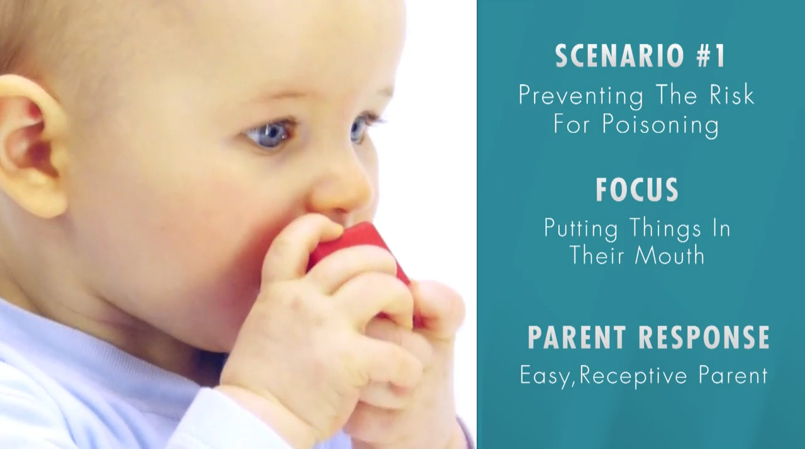
Video 1: Poisoning
Notes:
(Share a video with participants that is approx. 2 ½ minutes. You will require an internet connection.)
So now we are going to watch a series of videos. These videos were scripted by RECEs across Ontario. They will highlight different risks for injuries and parental responses to conversations on child safety. You are going to observe the RECE and parent response to different approaches using the What? So What? Now What? concept. Parents and caregivers respond in different ways when you engage them in child safety. Let’s start by watching a scenario where the parent is receptive to receiving child safety information.
(click on image to play video)
Post Video Discussion:
What strategies did the RECE use to discuss child safety with the mom?
Potential answers include:
What? So What? Now What? concept
Acknowledge that parenting can be a challenge
Non-verbal posturing (receptive, arms not crossed)
Respectful, non-judgmental language
Using open ended questions (what can the parent do in their own home that works for them; building their problem solving skills)
Encouraging parent to identify own solutions

Slide 24
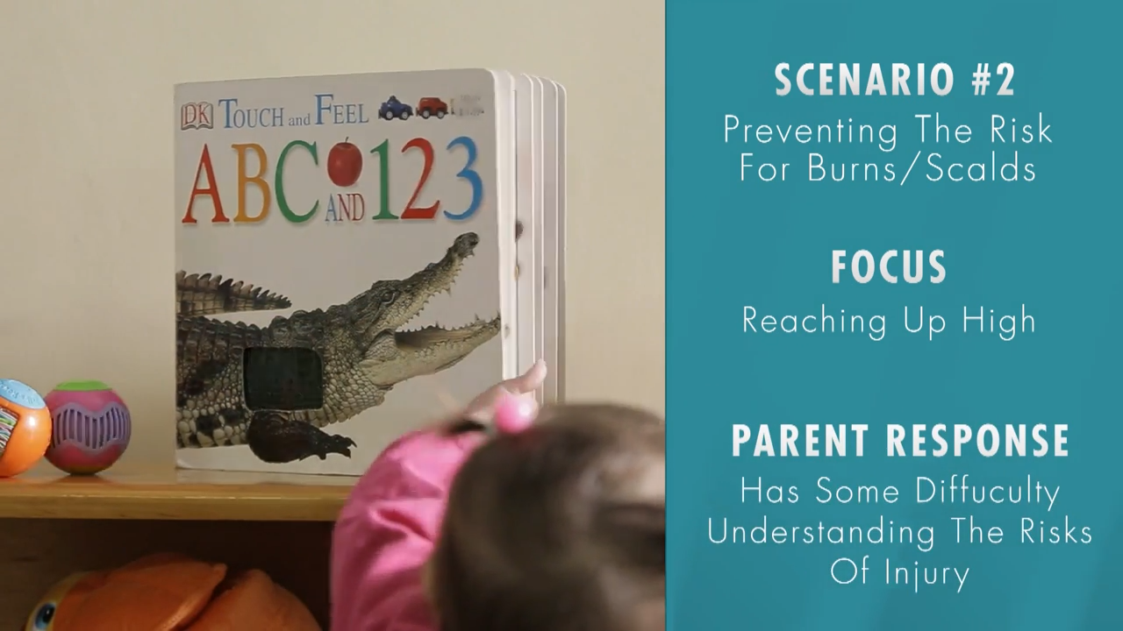
Video 2: Burns/Scalds
Notes:
This video is just over 3 minutes. (click on image to play video)
Post Video Discussion:
What new or different strategies did the RECE use to discuss child safety with the mom in this scenario?
Potential answers include:
Clarifying how a developmental skill is related to risk of injury
Visualizing home environment

Slide 25
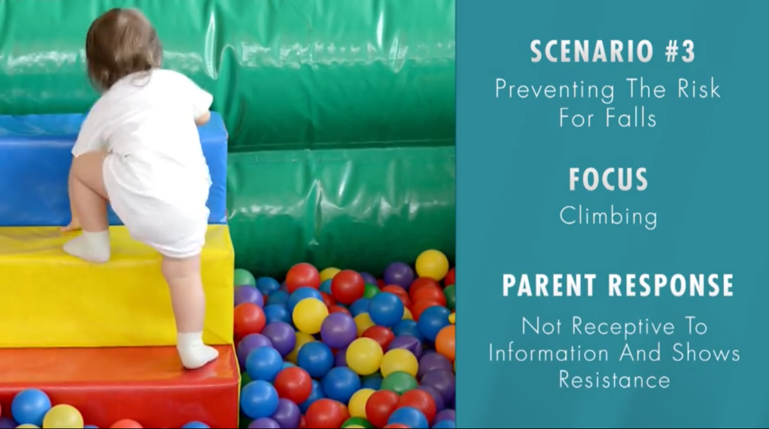
Video 3: Falls
Notes:
This video is just under four minutes. (click on image to play video)
Post Video Discussion:
What new or different strategies did the RECE use to discuss child safety with the mom in this scenario?
Potential answers include:
Encouraging play while balancing safety
Highlighting the severity of some injuries such as head injuries
Relating to personal experiences
Highlight:
There is no one strategy or solution that will work for every parent or caregiver. It is important for them to use their own parenting judgment and for us to help them develop those skills to make safe decisions. They know their children and homes the best. Through teachable moments we can help them identify risks and prevent injuries that work of them.
(Role Paly Activity: pending the needs of the group, ask them to role play a scenario using What? So What? Now What?)

Slide 26
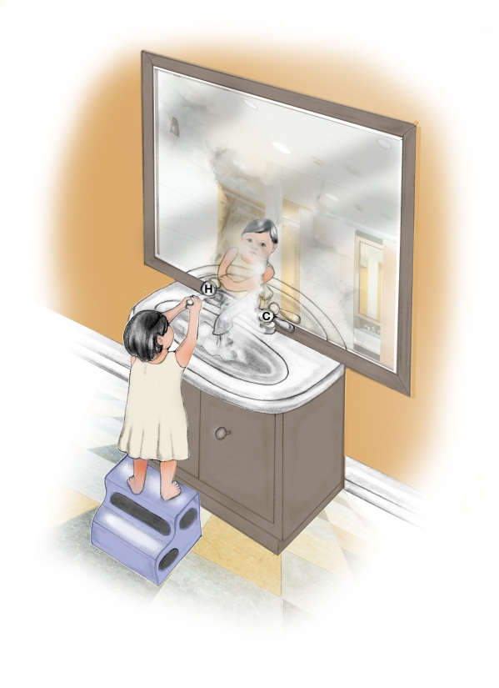
Website & Email Messages for Families
Notes:
Outside of providing messaging during workshops and teachable moments, we are asking you to promote a website and email messaging service to your families parents/caregivers

Slide 27
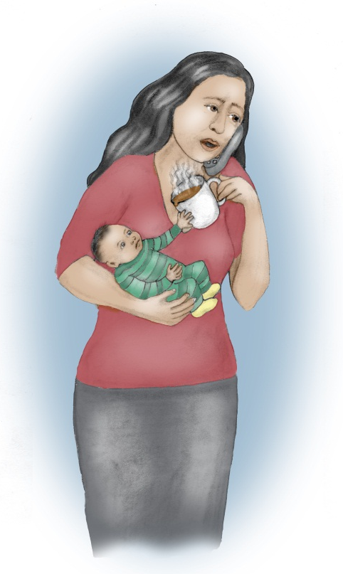
Website & Email Messaging System
www.preventchildinjury.ca
Will help parents/caregivers with child safety at home
Reminders specific to developmental milestone
Notes:
How the Website & Email Messaging System Work
preventchildinjury.ca is a simple website for parents, caregivers, and professionals to access child safety information
Parents and caregivers can also sign up to receive free emails about child safety based on their child’s age
The emails are framed using What? So What Now What?
All parents or caregivers have to do is enter in their email address and child’s birth date. The emails are then tailored to the child’s age to help them connect developmental milestones with risks for injury, as well as some prevention ideas to get them started. They also enter a password so that they can change their information at any time.
They can unsubscribe at any time.

Slide 28
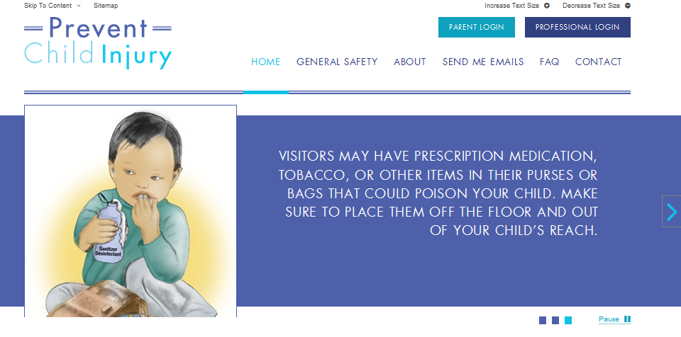
Notes:
There is a home, general safety, about, send me emails, frequently asked questions, and contact information sections on this website.
TIPS
When in slideshow mode: Move the mouse “arrow” over picture until “hand” appears, then click to automatically open to website

Slide 29
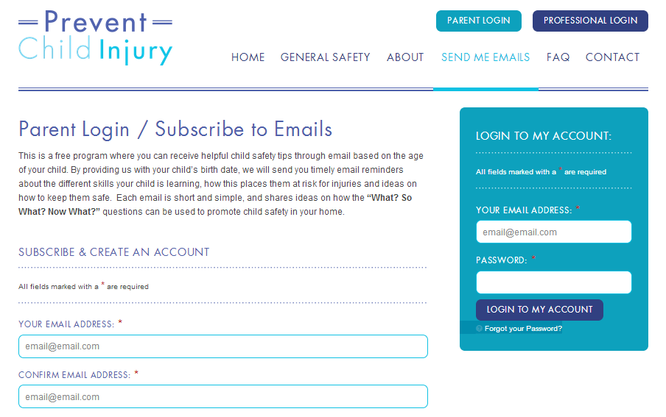
How to Register
Notes:
This is what the registration page looks like to receive the emails.
TIPS
When in slideshow mode: Move the mouse “arrow” over picture until “hand” appears, then click to automatically open to website

Slide 30
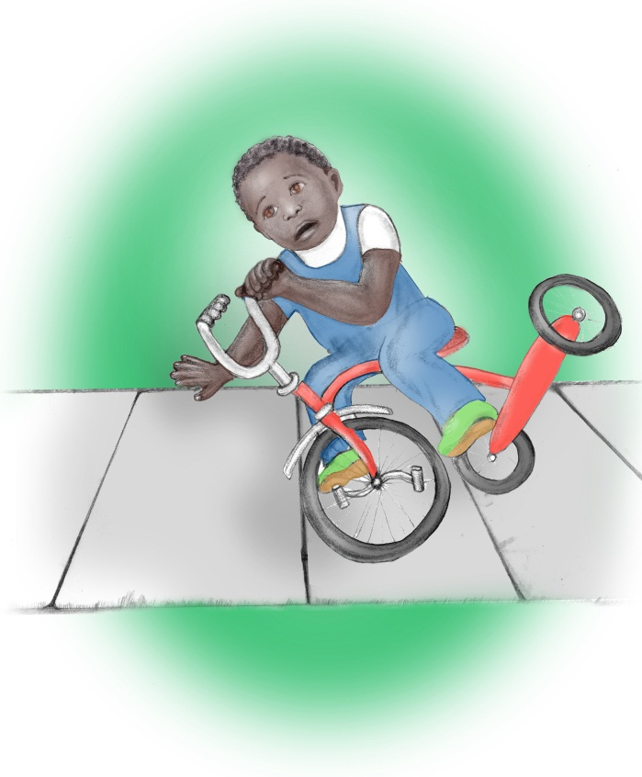
Resources and Supports
Notes:
There are many resources and supports available for both you and your families.

Slide 31
Other Injury Issues – What do I do?
Building injury prevention skillset
Transferring to other topics
Notes:
The What? So What Now What? concept is the start to assisting parents and caregivers prevent child injuries. Even though the key messages focus on falls, scalds, burns, and poisoning prevention, as mentioned earlier these questions can also help families prevent other types of injuries. What? So What Now What just helps to build the foundation.

Slide 32
Where to go for more information?
www.preventchildinjury.ca and register under the Professional Page
Local Public Health Unit
Parachute Canada
Health Canada
Ministry of Transportation
Notes:
If you don’t have the answers to specific child safety questions. Don’t worry. There are many resources available for you and your families. Encourage them to contact any of these agencies for more information.
The prevent child injury website includes a professional page. All the videos, presentations, illustrations, etc are available for you to use. There is also a series of links to reputable Canadian agencies that provide child safety information.

Slide 33
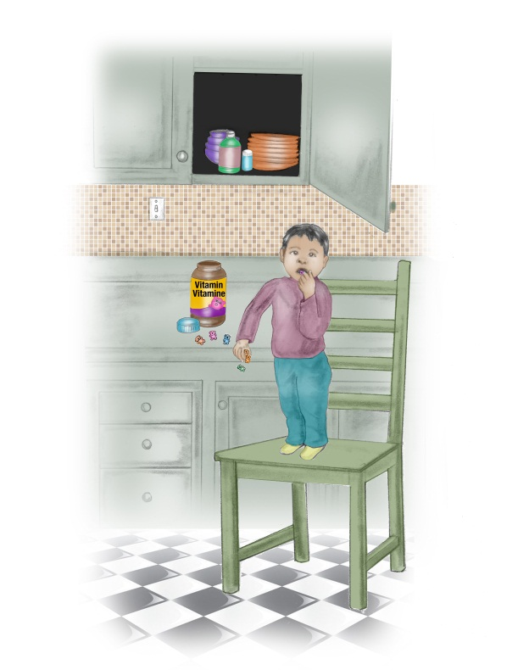
Next Steps
Plan a child safety workshop
Support one another in engaging in teachable moments
Share with colleagues
Notes:
While the information is fresh, intentionally apply this information in your day to day work.
Plan your first workshop within the programs and services you already deliver
Practice having conversations about child safety with a colleague (role play)
Engaging a parent or caregiver in a conversation about child safety
Support your colleagues in teachable moments
Share this information with your colleagues and train them to deliver workshops and engage in teachable moments
Share with your colleagues, parents, and caregivers the website and email messaging system

Slide 34
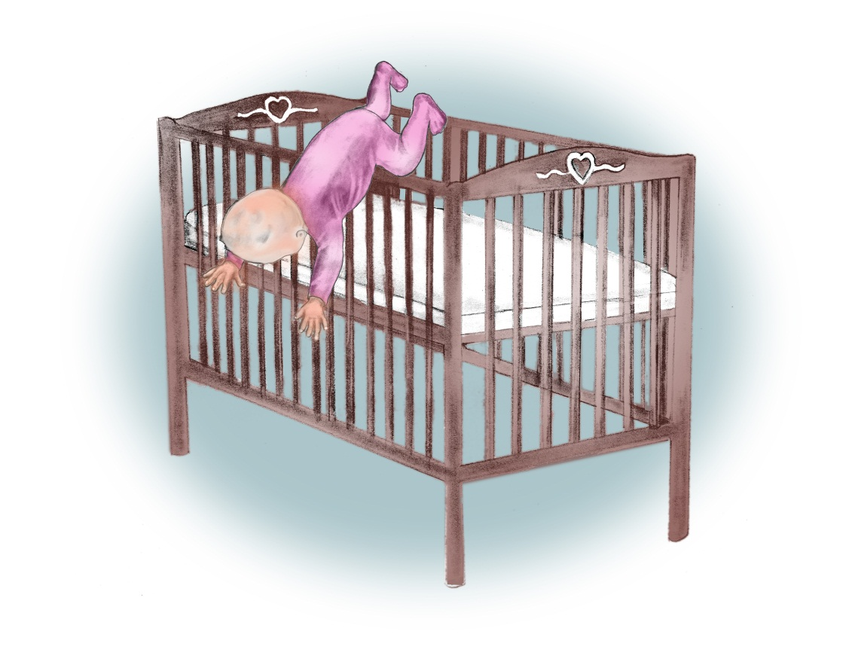
Questions?
Notes:
Frequently Asked Questions
Q: How do I familiarize myself with injury prevention resources?
A: You can always contact your local Public Health Unit for information on injury prevention. Or visit the prevent child injury website for links to Canadian organizations that address child safety.
Q: Where can I refer parents/caregivers who are interested in learning more about injury prevention?
A: You can always refer them to your local Public Health Unit for information on child safety.
Q: Does the email messaging system focus only on the top three injuries (i.e. falls, burns/scalds and poisonings) when sending the safety reminders?
A: Yes, at this time the messages only focus on these top three injuries. This focus was purposeful, as was the age range (i.e. 0 – 36 months). Over time, we hope to refine the website and the messaging strategy to provide more information for parents/caregivers. We also hope to include more types of injuries and include messages to inform parents/caregivers with children beyond the age of three.
Q: Do I have to create my own PowerPoint for the workshop?
A: No, you do not have to create your own PowerPoint presentation. We have created a template to assist facilitators with conducting the workshop. This will ensure that the workshop is delivered consistently. If a site does not have access to PowerPoint technology they will still have access to a hard copy that will serve as a guide.
Q: Is there any way that I can access the videos from the training session in case I need a refresher on how to approach those teachable moments?
A: Yes, you will be able to access the videos from the training session online through the prevent child injury website in the Professional section.
Friendly Reminders
Recruitment
Create a positive environment (i.e. in the workshop and during teachable moments)
Be confident when talking about the concept of “What, So What, Now What” and understand the components of the workshop (with reference to the facilitator guide).
Promote the email messaging system
Act on those teachable moments and role play what those conversations may look like
Remember that you (as the facilitator) and each parent/caregiver will be asked to evaluate the different components of this project to promote the program’s success

Slide 35
Thank you!!!!
Notes:
(Thank everyone for attending and participating in this training session.
Let them know that you are available after the session if they have any additional questions or concerns.)

